Slide 1
ASSESSMENT
IN THE EARLY YEARS
Early Hapsari
Sekolah Victory Plus

Slide 3
EARLY CHILDHOOD MILESTONE
Jean Piaget
https://www.youtube.com/watch?v=Yxo8zkgd07E

Slide 4
Vygotsky
Vygotsky; “Zone of Proximal Development”; More Knowledgeable Other
ZPD has become synonymous in literature with the term “scaffolding” (Saul Mc.Leod, www.simplypsychology.org)

Slide 5
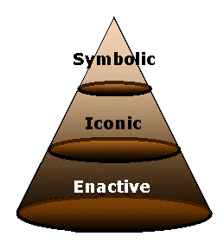
Bruner
Enactive representation (action-based)- 0-1 year
It involves encoding action based information and storing it in our memory.
Iconic representation (image-based)- 1-6 years
This is where information is stored visually in the form of images (a mental picture in the mind’s eye).
Symbolic representation (language-based)- 7 years onward
This is where information is stored in the form of a code or symbol, such as language.
www.simplypsychology.org

Slide 6
Constructivism
Standard C4, 7a;
the school ensures that students’ knowledge and understanding are assessed prior to the new learning.
Standard A, 3C;
The school is committed to constructivist, inquiry-based approach to teaching and learning that promotes inquiry and the development of critical-thinking skills.
Standard C2, 3;
the written curriculum builds on students’ previous learning experiences.

Slide 7
Constructivist Approach
We use our prior experiences and knowledge to make sense of new situations and construct new knowledge
Children constructing their meaning in a guided programme
Genuine acts of inquiry within a framework of teacher and child initiated experiences aimed at enhancing new learning and the development of enduring understanding

Slide 8
Constructivist Approach
Collaborative and cooperative learning are favoured in order to expose the learner to alternative viewpoints
Scaffolding is facilitated to help students perform just beyond the limits of their ability
Assessment is authentic and interwoven with teaching

Slide 9
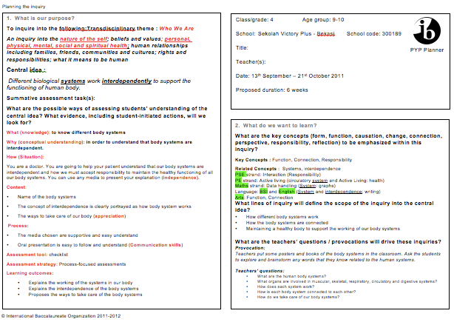
Do you see the connection?

Slide 10
What are the beliefs and values that drive the PYP?
Read MPYPH page 7, especially the last 3 paragraphs..

Slide 11
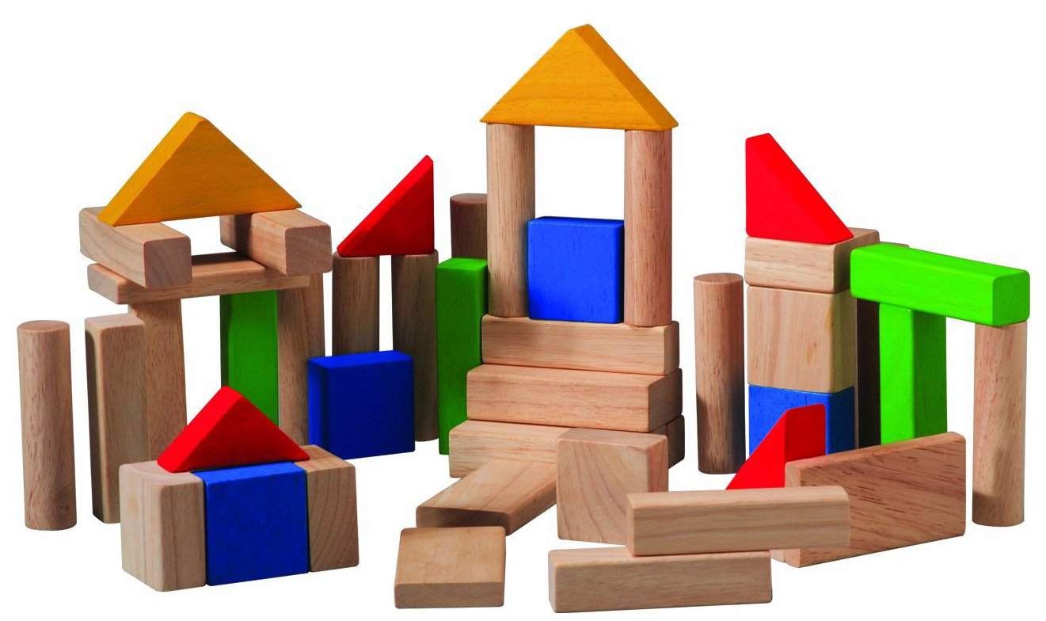
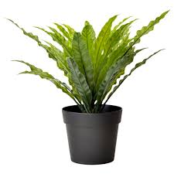
Example: Living and Non Living Things

Slide 12
From the Standard and Practices..

Slide 14
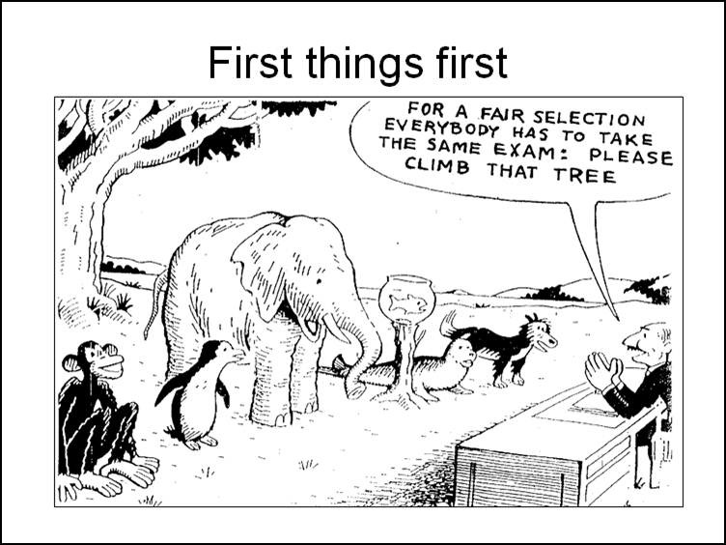
Assessment
Standard C4, 1a; assessment at the school is integral with planning, teaching and learning.

Slide 15
Purpose
to give feedback on the learning process
to improve students’ performance
to inform learning
Through formative and summative assessment

Slide 16
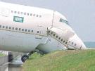
Would you like to be the passenger?
Pilot test result
Take off result: 9
Stays on the air result: 10
Landing result: 5
Average: 8

Slide 17
In today’s Classrooms assessment comes in two types;
Formative assessment - Assessment to improve learning, to provide feedback, reflection, to raise confidence, to focus on individual needs, to support student learning.
Summative assessment -to find out what the children have learned - will include knowledge, skills, attitudes, conceptual understandings and sometimes the action taken as a result of learning

Slide 18
Formative assessment = ongoing takes place all of the time, not always formal, does not always involve writing - may be verbal.
Summative assessment = at the end of a unit of work or learning sessions, usually has formal feedback (rubric, checklist, continuum etc)

Slide 19
Good assessment should not be about -
* Quantity of work
* Presentation of the work (display)
* Marking or grading
* Comparisons between students

Slide 20
Assessment will support children when….
learning intentions are shared with the children
children are involved in self-assessment
feedback that helps children to recognize what they need to do next is provided
every child feels confident that they can improve

Slide 21
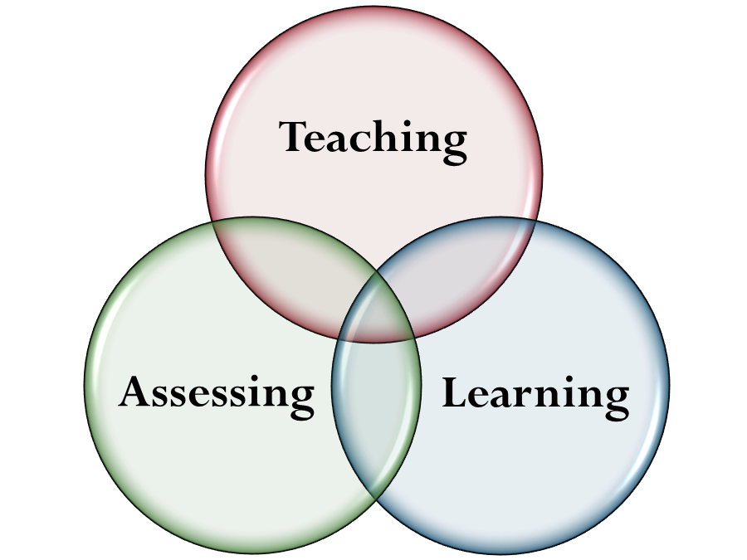
Teaching, learning and assessment
Assessment is ongoing
Assessment is integral to all teaching and learning
Assessment occurs both formally and incidentally at various points in a learning

Slide 22
Awareness Test Video
https://www.youtube.com/watch?v=Ahg6qcgoay4

Slide 23
What is authentic assessment?
Planned and structured so all students can understand the reasons behind the assessment tasks
Students should be aware of the desired results (learning intentions) and the acceptable evidence (criteria for success)
Done using different tools and strategies
Students should have a clear feedback

Slide 24
What is authentic assessment?

Slide 25
what do we assess?
Knowledge
Understanding
Skills

Slide 27
Stage 1: Identify desired results
What should students know, understand and be able to do?
Consider our goals, standards and curriculum expectations.

Slide 28
Stage 2: determine acceptable evidence
How will we know if students have achieved the desired results and met the standards?
What will be the evidence of students’ understanding?

Slide 29
stage 3: Planning and learning experiences and instructions
After identifying results (stage1) and appropriate evidence (stage 2), now we can plan the learning experiences

Slide 30
ASSESSMENT STRATEGIES AND TOOLS

Slide 31
Practice
Making WALT and WILF

Slide 33
When there is a correct answer
https://www.youtube.com/watch?v=9TskeE43Q1M

Slide 34
Morning Tea/Coffee Reading
Making PYP Happen page 47

Slide 35
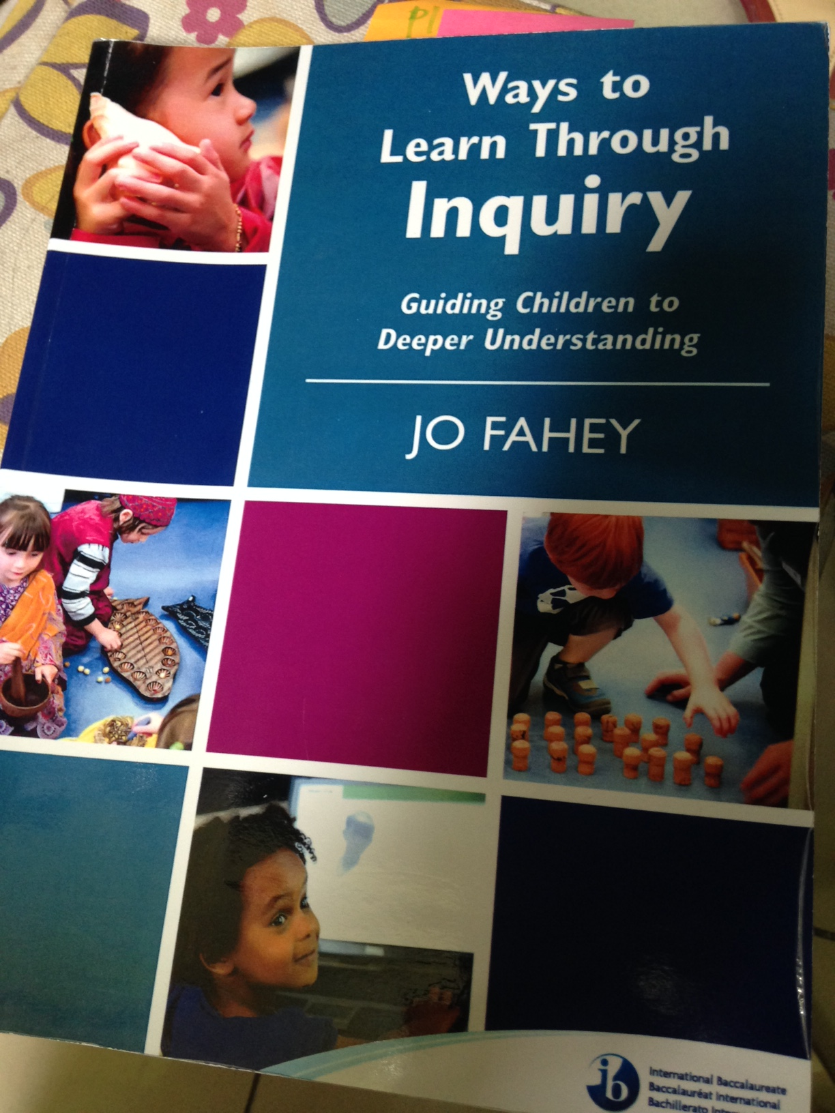
Assessing through… (adapted from ways to learn through inquiry; Jo Fahey)
…read-aloud and responses
…browsing and viewing
…organizing ideas
…play
…educational drama
…research
…the arts
How these help you to assess?

Slide 36
Assessment through read-aloud and responses
In an inquiry-based learning environment, oral language exposes the thinking of the learner and helps learners construct meaning and develop deeper levels of understanding.
Lev Vigotsky

Slide 37
Assessment through read-aloud and responses
Positive effect on students’ abilities as writers and readers
Fosters a love of reading
Enhances literacy outcomes
Using a range of texts; fiction, information texts, magazines, newspaper, electronic texts
Promotes thinking and discussions
Connect to children’s prior knowledge and experience (reflection)
Offers new perspective
Provokes children to communicate ideas

Slide 38
Assessment through browsing and viewing
Lynell Burmark
Welcome to the age of images. The signs are everywhere-for those who can read them.

Slide 39
Assessment through browsing and viewing
We process visuals 60.000 times faster than we process written text.
Children under the age of 5 can work out ways to interpret images.
As a provocation for conversation.
Provokes spontaneous questions
Prompted with open-ended questions (what do you notice?)
Stimulate young children to learn written text
Interesting; photographs, illustrations, diagrams, pop-ups, and flaps
As a visual and universal language

Slide 40
Assessment through organizing ideas
To find meaning in something..is to locate that item in a framework which connects to something in our own experience, something which already makes sense to us. Matthew Lipman.

Slide 41
Because Thinking is Messy!
Using external tools for thinking
Help children generate, organize and synthesize their ideas
Using Graphic Organizers (recognized or teacher/students creation);
Provide a framework for processing ideas
Reduce the working memory load
Make it possible for children to see the bigger picture
Make generalizations
Keep in mind the process of inquiry
Can incorporate symbols, photographs, illustrations and real objects

Slide 42
Assessment through play
…we view all definitions of play as forms of inquiry that occur both within and beyond educational settings.
-Joan Youngquist and Jan Pataray Ching -

Slide 43
Sociodramatic play: dramatic or pretend play, children interacting while role playing.
Benefits:
A sense of a shared purpose and in-depth inquiry
Promotes cognitive development
Socialization
Problem solving skills
Literacy development
Provides a window on how children represent their worlds

Slide 44
Not all play leads to significant learning!
Lev Vigotsky; the play that leads to significant learning largely depends upon adult mediation.
What we can do:
Combine play with units of inquiry
Intentionally create a learning environment for play-as-inquiry
Tap into children’s unique, creative ideas
Incorporate the transdisciplinary skills
Incorporate literacy and numeracy

Slide 45
Assessment through drama
Children know and understand things they are barely conscious of knowing or understanding. Drama can act as a catalyst that brings knowledge and understanding of the surface where it can, at last, be use to its owner.
Dorothy Heathcote

Slide 46
Process or educational drama
It is NOT performance drama. No formal audience.
Problem based; by teacher or children
Can be designed as a summative assessment
Can be combined with sociodramatic play
Allows children to identify problem and take action to solve it
Drama is a holistic way of inquiring that can involve:
Oral language
Body language
Visual language
Written language
Mathematics
Social skills

Slide 47
Assessment through research
There is a fundamental human urge to…understand the world!
-Margaret Donaldson-

Slide 48
Research through:
People
Place
Conducting experiments
Artifacts
Texts

Slide 49
Assessment through the arts
Learning about and through the arts is fundamental to the development of the whole child, promoting creativity, critical thinking, problem solving skills and social interactions.
-International Baccalaureate-

Slide 50
GALLERY WALK
One representative from each school will be in the booth with the portfolio and assessment record
The other will walk around to see others’ portfolio

Slide 51
Find at least 3 different portfolios from 3 schools
IDENTIFY THE DIFFERENCES AND SIMILARITIES BETWEEN THEM
WHAT DO YOU THINK NEED TO BE THERE?
WHAT Is SHOWING STUDENTS’ AUTHENTIC ASSESSMENT EVIDENCE?
What can you use to modify your current portfolio?

Slide 52
Another Reading
MPYPH “Documentation”, page 50

Slide 53
Assessment Recording
What is your current practice to record your students’ assessment result?
Assessment Record; What needs to be there?

